Slide 1
Ordering
Preoperative
Tests

Slide 2

Definitions
Local Medical Review Policies (LMRP)
LCD (Local Coverage Determination)
NCD (National Coverage Determination)
Specify under what clinical circumstances a service is considered to be reasonable and necessary (sometimes referred to as “Medically Necessary”). The Center for Medicare and Medicaid Services (CMS) further defines them as administrative and educational tools to assist providers in submitting correct claims for payment.

Slide 3

Definitions
International Classification of Diseases, 10th Revision, Clinical Modification(ICD-10-CM)
ICD-10-CM is the official system used in the United States to classify and assign codes to health conditions and related information.

Slide 4

Definitions
Current Procedural Terminology (CPT)
CPT is a system developed by the American Medical Association for standardizing the terminology and coding used to describe medical services and procedures which serves as the basis for health care billing.

Slide 5

Z-Codes
Classification of Factors Influencing Health Status and Contact with Health Service
  Z-Codes deal with occasions when circumstances other than a disease or injury are recorded as a diagnosis or problem.
Four primary circumstances for the use of Z codes:
  A person who is not currently sick encounters the health services for some specific reason, such as to act as an organ donor, to receive prophylactic care, such as inoculations or health screenings, or to receive counseling on health related issues.
  A person with a resolving disease or injury, or a chronic, long-term condition requiring continuous care, encounters the health care system for specific aftercare of that disease or injury (e.g., dialysis for renal disease; chemotherapy for malignancy; cast change). A diagnosis/symptom code should be used whenever a current, acute, diagnosis is being treated or a sign or symptom is being studied.
  Circumstances or problems influence a person’s health status but are not in themselves a current illness or injury.
  Newborns, to indicate birth status

Slide 6

Meeting medical necessity
All ordered tests must meet “Medical Necessity” in order to be reimbursed for the test!
Meeting “Medical Necessity” is accomplished when the test ordered (CPT Code) is allowed by the diagnosis (ICD-10-CM Code) for which it is ordered.
The LMRP, LCD, and/or NCD specifies which ICD-10-CM(s) will authorize the CPT procedure being ordered (e.g. meeting “Medical Necessity”).

Slide 7
Medical necessity
Health services that are:
  Reasonably necessary to prevent illness or medical conditions, or provide early screening, interventions, and/or treatments for conditions that cause suffering or pain, cause physical deformity or limitations in function, threaten to cause or worsen a handicap, cause illness or infirmity of a recipient, or endanger life.
  Provided at appropriate locations and at the appropriate levels of care for the treatment of clients’ conditions.
  Consistent with health care practice guidelines and standards that are issued by professionally-recognized health care organizations or governmental agencies.
  Consistent with the diagnoses of the conditions.
  No more intrusive or restrictive than necessary to provide a proper balance of safety, effectiveness, and efficiency.

Slide 8
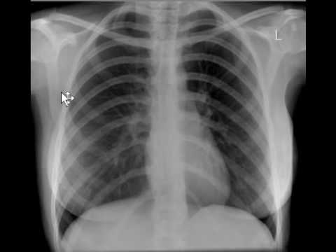

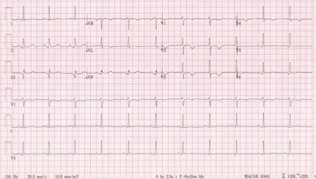

Meeting medical necessity
Meeting “Medical Necessity” also applies to Preoperative Testing!
Chest X-Ray
ECG
PT/PTT

Slide 9

CMS directives
“All claims for preoperative medical examination and preoperative diagnostic tests (i.e., preoperative medical evaluations) must be accompanied by the appropriate ICD-10 code for preoperative examination.”
“The ICD-10 code that appears in the line item of a preoperative examination or diagnostic test must be the code for the appropriate preoperative examination.”
“Additionally, the appropriate ICD-10 code for the condition(s) that prompted surgery must also be documented on the claim.”
“Other diagnoses and conditions affecting the patient should also be documented on the claim, if appropriate.”

Slide 10
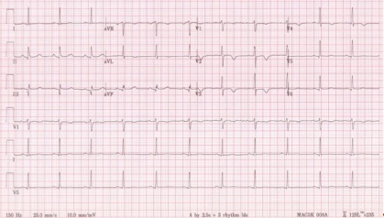
Medical Necessity for EKG
Preoperative:
  Z01810 (pre-operative cardiovascular examination).
  Z01818 (pre-operative examination, unspecified).
Others:
R9431 (abnormal ekg)
I252 (old myocardial infarction)

Slide 11
Medical Necessity for CXR
Preoperative: Z01811 (pre-operative respiratory examination).
Others
A021 (salmonella sepsis)
A221 (pulmonary anthrax)

Slide 12

Medical Necessity for CBC
Section 8.2.39.3 - Blood Counts
“Texas Medicaid considers a baseline CBC appropriate for the evaluation and management of existing and suspected disease processes. CBCs should be individualized and based on client history, clinical indications, or proposed therapy and will not be reimbursed for screening purposes.”¹
  http://www.tmhp.com/HTMLmanuals/TMPPM/2011/2011TMPPM-30-212.html

Slide 13

Medical Necessity for other Bloodwork
The Medical and Nursing Specialists, Physicians, and Physician Assistants Handbook DOES NOT state medical necessity for other bloodwork (e.g. Protime, PTT, Chem Panels, etc.). However, it can be assumed the medical necessity would encompass at least the same standards as for the CBC:
  “Texas Medicaid considers a baseline CBC (bloodwork) appropriate for the evaluation and management of existing and suspected disease processes. CBCs (bloodwork) should be individualized and based on client history, clinical indications, or proposed therapy and will not be reimbursed for screening purposes.”

Slide 14
ICD-10 Codes FOR PREOPERATIVE TESTING
Select the primary diagnosis (Preoperative Testing) from the following ICD-10 codes:
  (pre-operative cardiovascular examination) Z01810 – Covers EKG
  (pre-operative respiratory examination),Z01811
  (pre-operative laboratory examination),Z011812
  (pre-operative examination, unspecified), Z01818 – Covers EKG
Then list the ICD-10 code indicating the reason for the surgery as the secondary diagnosis.
You should also Include any additional diagnoses on the claim which may be relevant to the pre-operative service(s).
  This diagnosis or condition can show medical necessity for some of the preoperative tests ordered.

Slide 15

Ordering preoperative tests
Principle Diagnosis
Reason for Admission
Secondary Diagnosis
Reason for Surgery
Other
Diagnosis(es)
Relevant to Preoperative Services

Slide 16

Questions

